Slide 2
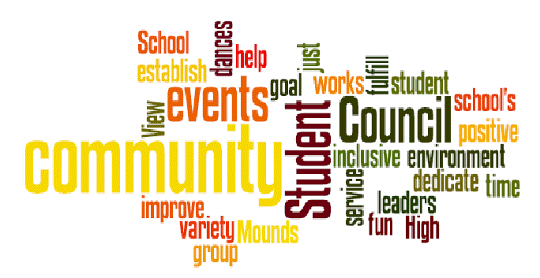
Student Council
Travis Wood
Gwen Leiter
Akshara Nimmagadda
Max Bandurski

Slide 3
What's The Point?
Students experience responsibility.
Push students to think creatively and smartly.
Help others in small ways.

Slide 4
What Do We do?
Raise Money For Charities
Hold Fundraisers for charities
Hold pretzel/apple sales and school stores to raise money
Help fund things to help our school
Think of ways to make Bridge Valley a better place

Slide 5
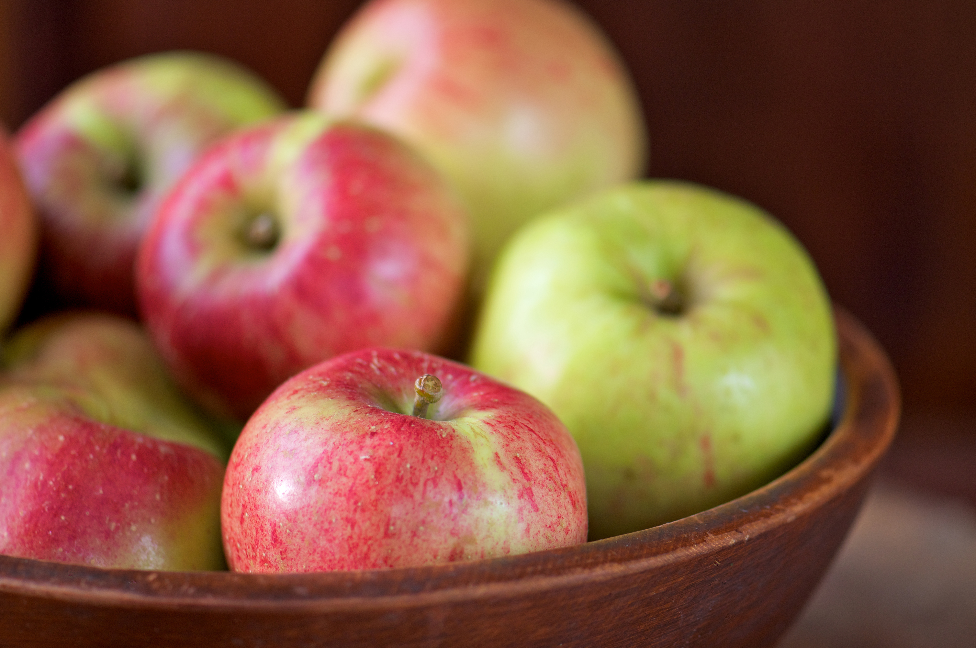
Benefits
Helps run school stores\ pretzel and apple sale
Helps bring awareness to problems that teachers don’t know
Gives ideas of how to help make every day amazing
Are the voice of the students

Slide 6
In Conclusion...
Student council helps the school and community in many ways including
Fundraisers
Helping students experience responsibility
Help bringing awareness to small problems

